Slide 1
Unlocking Letters and Sounds
Phase 2: Set 2

Slide 2
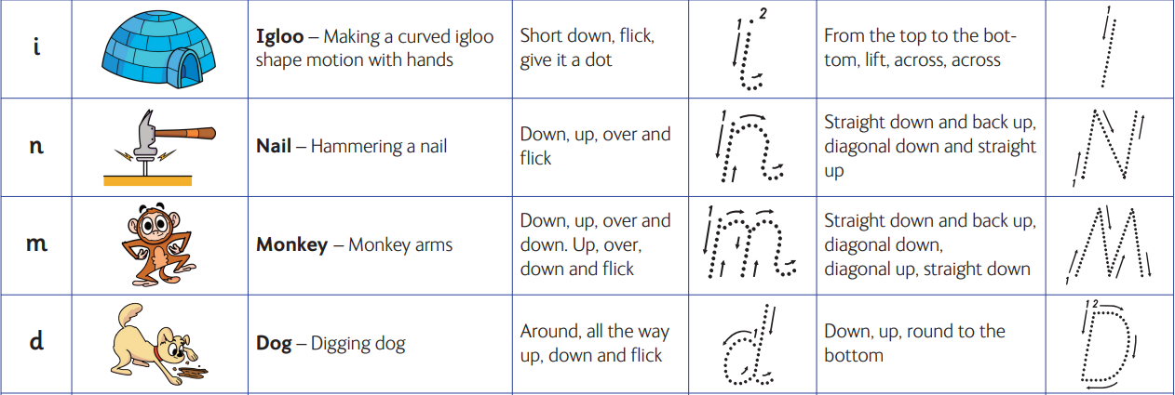

Slide 3
