Slide 1
Unlocking Letters and Sounds
Phase 2: Set 4

Slide 2
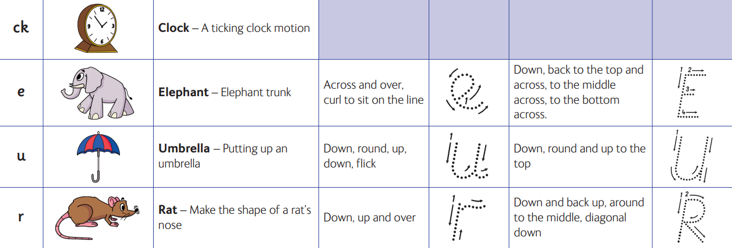

Slide 3
