Slide 1
Unlocking Letters and Sounds
Phase 3: Set 2

Slide 2
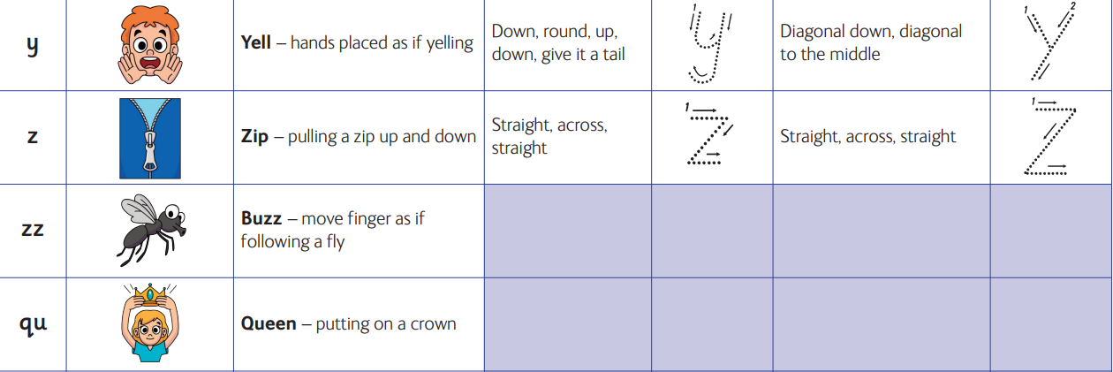

Slide 3
