Slide 1


Unlocking Letters and Sounds
Phase 3: Vowel Digraphs

Slide 2
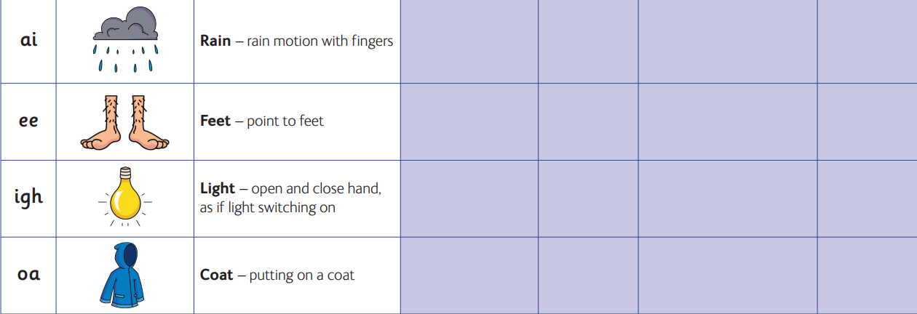

Slide 3


